Slide 1
LIBS 7001: Week 6(a)
© BCIT
Adapted from original slides by G.Homel and C.Liotta

Slide 2
Research Writing
(SSW, Ch. 19)
gathering information from a variety of sources
focusing, organizing, presenting it in a formal paper that documents your sources.
can be open-ended: a tentative exploration of a position or idea related to self and society
common both in the classroom and on the job:
  analyze potential of a new product
  evaluate different exercise programs following arthroscopic surgery
* from Strategies for Successful Writing, Ch. 19-21; and * in Writing in the Academic Disciplines 1870-1991, quoted by R. Davis and M. Shade, “’Building a Mystery’: Academic Research Writing & the Academic Art of Seeking,” CCC 51:3, Feb. 2000, 424.

Slide 3
Why a Persuasive Research Essay?
(adapted from Davis)
presents your view (reasoned argument) on a topic of interest to you professionally and as a citizen
“essay” ~ trial, an exploration: creating new knowledge (via an original thesis) can be approached
can draw from personal experience
The decisions you make in organizing an argument are creative ones: research essays are rigorous and creative -- not simply presenting facts and ideas from other sources.

Slide 4
Planning a Research Paper
(SSW, Ch. 19; Diana Hacker. A Canadian Writer's Reference , Sec. C)
1. Establish staged completion dates:
  topic determined:
  draft due:
  final due:
2. Assess the writing situation by looking at
  (A) the subject of your writing
  (B) purpose, and audience
  (C) sources of information.
3. Explore ideas.
4. Develop a thesis statement.
5. Organize/write/revise your paper & document your sources.

Slide 5
(2A) Choose a Subject (Topic)
Hacker, Section C
Consider these questions:
  Has the subject been given to you, or are you free to choose your own?
  Why is the subject worth writing about?
  How broadly can you cover the subject within space / time limits? How detailed should your coverage be?
  Do you need to narrow it to a more specific topic?

Slide 6
Draw on Your Interests
(adapted from SSW)
Choose a topic relevant to your work or cultural interests, which creates a richer process and helps you over rough spots & boredom
Use brainstorming, outlining, or clustering to focus your ideas: The more you brainstorm, the richer your store of ideas will be.
State your major research question, followed by related questions that elaborate on it.

Slide 7
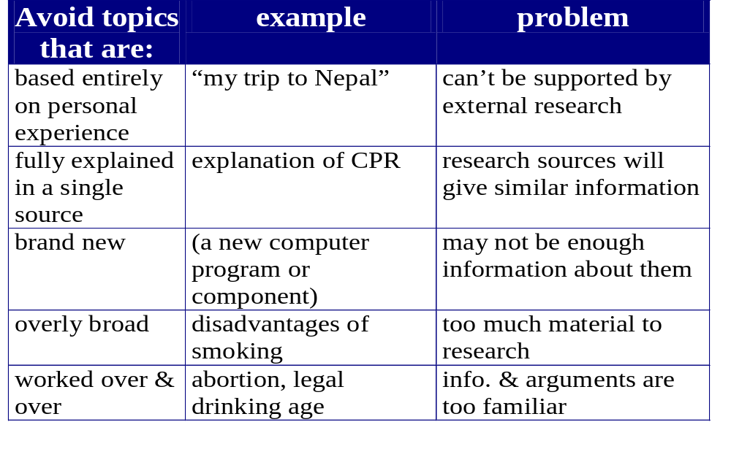
see SSW topic exercises

Slide 8
(2B) Define Purpose & Audience
Hacker, Section C
Why are you writing:
  - to inform - to explore
  - to entertain - to persuade
  - to call readers to action - some combination of these?
Who are your readers:
  How well informed are they about the subject?
  What do you want them to learn about the subject?
  How interested and attentive are they likely to be?
  Will they resist any of your ideas?

Slide 9
Audience, cont.
What’s your relationship to the audience:
  Employee to supervisor?
  Citizen to citizen?
  Expert to novice?
  Scholar to scholar?
How much time are they willing to spend reading?
How sophisticated are they as readers?
Do they have large vocabularies?

Slide 10
(2C) Identify Information Sources
SSW, Ch. 20; Hacker, Section C
Where will your information come from:
  Reading (books / articles / Internet)?
  Personal experience?
  Direct observation?
  Questionnaires? Interviews?
  Viewing / Listening (radio, films, tv)?
What sort of documentation of your sources is required?
  LIBS 7001 requires a recognized system of documentation

Slide 11
Library & Other Resources
(adapted from SSW, Chs. 19 & 20)
Familiarize yourself with library resources -- not just those at BCIT.
  People: consult reference and subject-area librarians
  Library Catalogues: on-site and via Internet connections - for BCIT and other libraries
  Computerized databases: listing of newspaper / magazine article titles &/or full text
  “Hard copies”: stacks, periodicals, reference section
Know the limits and snares of Internet research.

Slide 12
The Sources You Use for Research Should Be. . .
authoritative (credible)
  having experience, qualifications, background on the subject you are researching
representative (fair sample of the source’s expertise)
  e.g., Michael Jordan on basketball, not underwear
current (presenting the most up-to-date research)
  most of your sources: within the past five years
  exceptions: highly influential “classics” in a discipline: Aristotle/political theory; J.K. Galbraith /economics

Slide 13
(3) Explore Your Ideas
(SSW, 278-280; Hacker, Section C)
clustering : shows relationship among ideas: write topic in the centre of a sheet of paper; draw a circle around it, and surround the circle with related ideas connected to it with lines.
topic

Slide 14
Techniques for Exploring Ideas
(SSW, Hacker)
clustering example: Walkerton, Ont. water crisis
under-
funding
age
victims’
health
Walkerton
deaths
prov ’l.
illness
equip.
staff
local

Slide 15
Exploring Ideas, cont.
(SSW, Ch. 19; Hacker, Section C)
branching: put main idea at top of the page, major supporting ideas beneath it, with space between ideas; branch out to minor ideas:
Smoking ban in pubs
  employees
  health general environment
  patrons
  ? lower profits / owners
  finances more $ spent: government / inspectors
  money saved smoking patrons
  less alcoholism?

Slide 16
Exploring Ideas, cont.
SSW, Ch. 19 (also Ch. 2); Hacker, Section C
listing: list ideas in the order in which they occur to you: a.k.a. “brainstorming”. Later, you can rearrange the order.
asking questions to generate ideas: (who, what, when, where, why, how)
freewriting: nonstop writing (ten minutes or so) -- write on the topic without pausing; loosen up, see what emerges; organize later.

Slide 17
(4) Formulate Your Thesis
SSW, Ch. 2; Hacker, Section C
Settle on a tentative central idea, asserted in one sentence (thesis), usually containing a key word or controlling idea that limits its focus.
Formulate a tentative thesis early on in the writing process; refine it for the final draft
  tentative: Government cutbacks led to the tainted water disaster in Walkerton, Ontario.
  final: Provincial government financial cutbacks to municipalities were a major contributing cause of the recent Walkerton, Ontario health crisis and deaths.

Slide 18
(5) Organize, Write, & Revise Your Essay
Informal Outline:
  List the thesis, followed by major supporting ideas.
Formal Outline:
  Put the thesis at the top.
  Use parallel grammatical structure for ideas at the same level of generality.
  Use sentences unless phrases are clear.
  Use conventional system of numbers and / or numbers and letter for the levels of generality.

Slide 19
Formal Outline Organization
Thesis:___________________________________________
1. Major idea
A. Second-level idea, supporting (1)
B. Second-level idea, supporting (1)
1. Third-level idea, supporting (1B)
2. Third-level idea, supporting (1B)… (etc.)
Thesis:___________________________________________
1. Major idea
1.1. Second-level idea, supporting (1)
1.2. Second-level idea, supporting (1)
1.2.1. Third-level idea supporting (1.2.)
1.2.2. Third-level idea supporting (1.2.)… (etc.)

Slide 20
Organize, Write & Revise, cont.
(SSW, Ch. 2-3)
Determine your thesis
Write the first draft
Revise and edit - consider
  the whole essay - overall organization
  paragraph development & transitions
  sentences and words
Refine your Introduction and Conclusion
Properly and fully document all your sources
Proofread. Proofread. Then proofread again.

Slide 21
Internet Research:
Some Limits and Snares
Not all knowledge / information is “on the Internet.”
The biases and defects of Internet sources may be hard to detect, especially outside of your own discipline: polished layout and graphics can conceal many flaws.
Ease of access to the Internet sources can make you a lazy researcher; you may overlook key hard-copy sources or become convinced they are not needed.
Web sites can use material from other sources without attribution, leaving you open (unwittingly) to charges of plagiarism if you quote from the site.

Slide 22
Evaluating Internet Sources
(SSW, pp. 294-299)
Are you picking useful herbs or poisonous plants?
Check the accuracy and validity of information
obtained from the Internet. Does the site have:
a source identified as a reputable professional organization? (City of Richmond; BCMA)
an identifiable author whose credentials can be checked?
professional tone? professional spelling, layout, etc.?
information consistent with other material you’ve found?
explanations of how site data were obtained?
any data that are misused?

Slide 23
How to Use Internet Sources
Use only reliable WWW sites.
Download information you think you will use: the site might change / you might not write down the correct URL.
for web sites, you will need to record
  Title, Author, URL of exact page you use
  (if present) date site was created or revised
  date YOU ACCESSED the site
Using downloaded text from Internet sites without using “ “ &/or giving credit is plagiarism, a serious professional and academic offence.

